Slide 1



Mental Health First Aid

Slide 2
Train as a Mental Health First Aider (MHFAider®) and receive three years of support and benefits
This course is ideal for those who would like to become an MHFAider® to:
Gain the knowledge and skills to spot signs of people experiencing poor mental health
Be confident starting a conversation and signpost a person to appropriate support
Alongside the best evidence-based Mental Health First Aid (MHFA) training, MHFAiders® are also provided with three-year access to ongoing learning and support through the MHFAider Support App®.
The app gives you 24/7 digital support, access to exclusive resources, ongoing learning opportunities, and the benefit of joining England’s largest community of trained MHFAiders®.

Slide 3






Benefits of our Mental Health First Aid course
Reduces stigma around mental ill health
Gives you increased confidence to have a supportive conversation about mental health
Promotes equity and understanding around mental health from different perspectives
Helps to build supportive communities and promotes open conversations about mental health
Encourages self-care, giving you the tools to look after your own and others' mental health
Promotes early intervention and recovery, which can prevent an individual's mental health deteriorating

Slide 4
Learning outcomes
As an MHFAider® you will be able to:
Recognise those that may be experiencing poor mental health and provide them with first-level support and early intervention
Encourage a person to identify and access sources of professional help and other supports
Practise active listening and empathy
Have a conversation with improved mental health literacy around language and stigma
Discuss the role in depth, including boundaries and confidentiality
Practise self-care

Slide 5
MHFAider® support
MHFA training doesn't stop when the course comes to an end. MHFA England offers continuous support for MHFAiders®, well beyond your initial certification, to ensure you can lead impactful MHFA interventions.
As an MHFAider® you will get automatic 24/7 digital support through the MHFAider Support App®. From there, you'll find exclusive resources, ongoing learning opportunities to grow your confidence, and gain the benefit of joining England’s largest community of trained MHFAiders®.​
This support will give you an opportunity to:
Keep your learning alive
Quickly reference something
Connect you with a group of people improving the mental health of the nation
​

Slide 6

MHFAider Support App®

Slide 7
MHFAider Support App®
The app empowers you as MHFAider® with the following features:
Secure conversation logging for you to make reflective notes to record and reflect while protecting confidentiality
Reminders for wellbeing check-ins with people you are supporting
24/7 text support service through Shout, for advice and reassurance on a Mental Health First Aid conversation or to support your own wellbeing after a difficult conversation
Resource library of toolkits, guidance, animations and core mental health concepts to support the you in your role as MHFAider®
Signposting database through Hub of Hope to find local and national mental health services for additional support

Slide 8
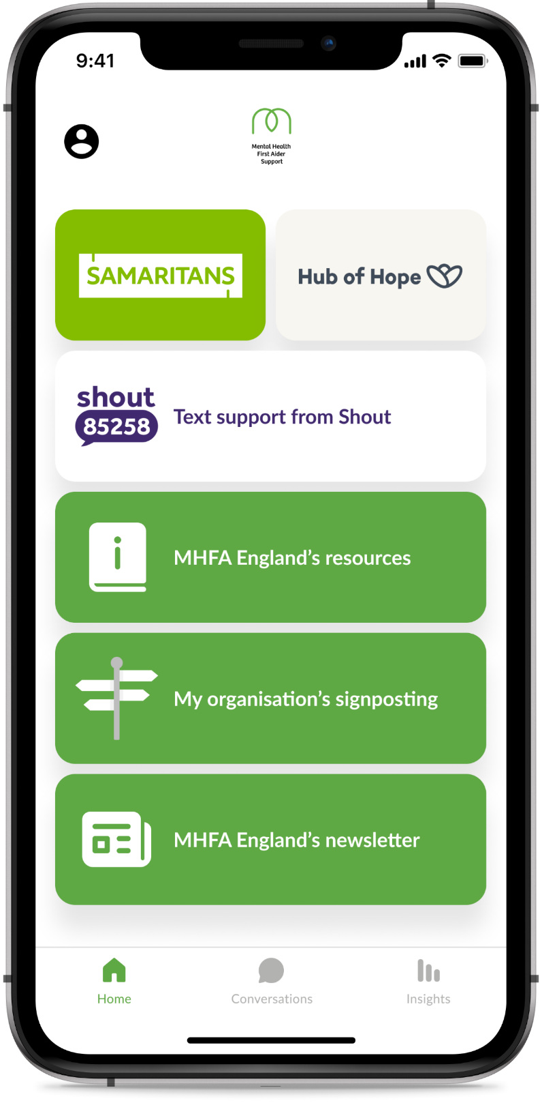
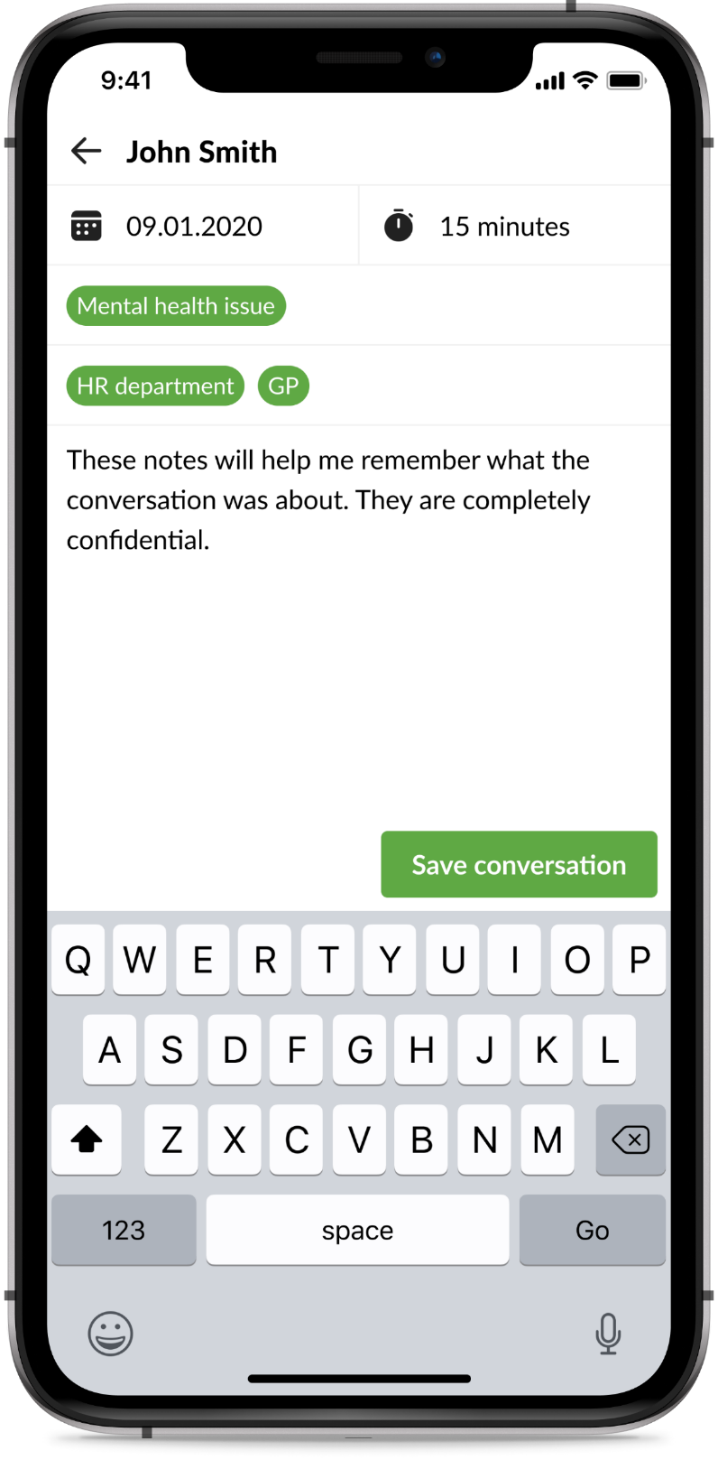
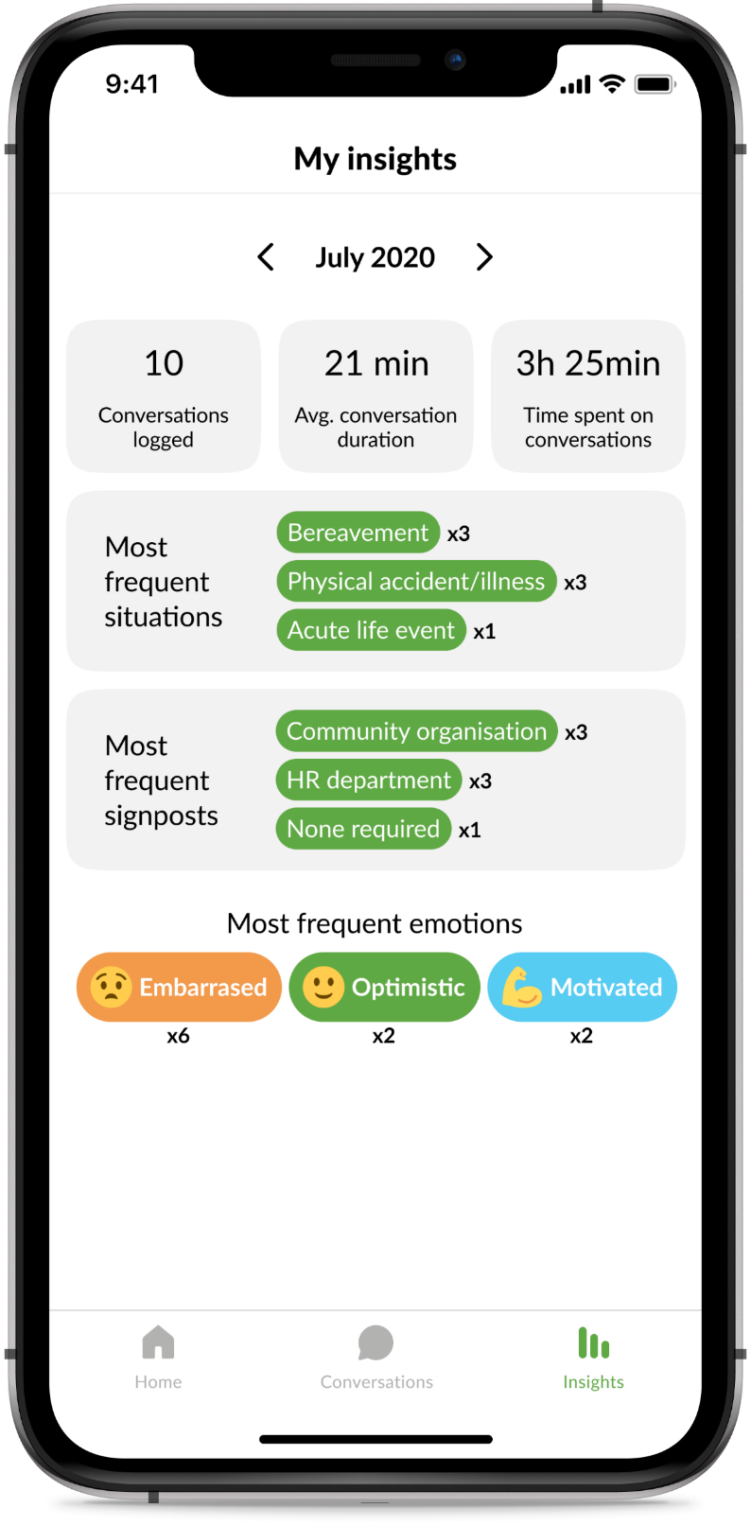
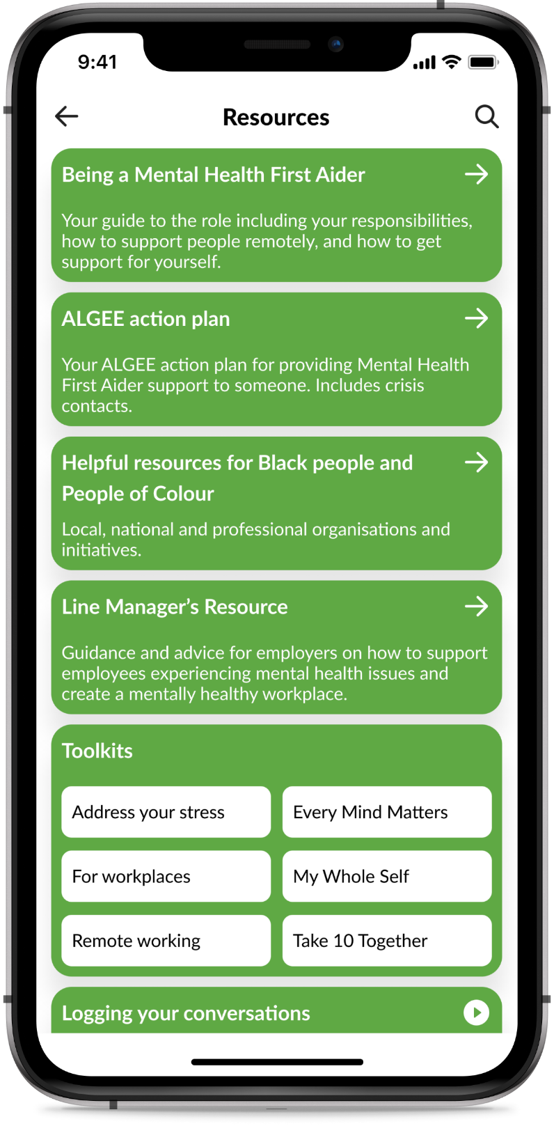
MHFAider Support App® features
Home screen
Conversation logging
Insights
Resource library

Slide 9

MHFAider® learning

Slide 10
MHFAider® learning
As an MHFAider® you’ll also have access to ongoing learning to support you in the role and ensure you have the most up-to-date information on mental health.
Over the three years, you will benefit from:
A library of resources that will support you to have impactful conversations
MHFAider® online events, exploring different topics and themes around mental health and the MHFAider® role
Exclusive MHFAider® content, regular online events to provide further learning and support so you are confident to perform your role effectively, long after your training

Slide 11
Why MHFA England training?
91% of people had a better understanding of mental health after completing their MHFA England course
Since MHFA England was founded in 2007, our Instructor Members have trained hundreds and thousands of MHFAiders®
All MHFA England Instructor Members are accredited by the Royal Society of Public Health, meaning you can expect a quality assured and consistent training experience
We are committed to improving the mental health of the nation

Slide 12

Thank you

